Slide 1
Encipherment Using
Modern Symmetric-Key Ciphers

Slide 2
Objectives
❏ To show how modern standard ciphers, such as DES or AES, can be used to encipher long messages.
❏ To discuss five modes of operation designed to be used with modern block ciphers.
❏ To define which mode of operation creates stream ciphers out of the underlying block ciphers.
❏ To discuss the security issues and the error propagation of different modes of operation.
❏ To discuss two stream ciphers used for real-time processing of data.

Slide 3
Modes of Operation
Block ciphers encrypt fixed size blocks
e.g., DES encrypts 64-bit blocks, AES 128-bit block
Need some way to en/decrypt arbitrary amounts of data in practice normally much bigger than 64 or 128 bits.
Modes of operation have been devised to encipher text of any size employing either DES or AES.
NIST SP 800-38A defines 5 modes
Have block and stream modes
To cover a wide variety of applications
Can be used with any block cipher
In essence, a mode of operation is a technique for enhancing the effect of a cryptographic algorithm or adapting the algorithm for an application, such as applying a block cipher to a sequence of data blocks or a data stream.

Slide 4
USE OF MODERN BLOCK CIPHERS
Symmetric-key encipherment can be done using modern block ciphers. Modes of operation have been devised to encipher text of any size employing either DES or AES.
Topics
Electronic Codebook (ECB) Mode Cipher Block Chaining (CBC) Mode
Cipher Feedback (CFB) Mode
Output Feedback (OFB) Mode
Counter (CTR) Mode
NIST SP 800-38A defines 5 modes that can be used with any block cipher

Slide 5
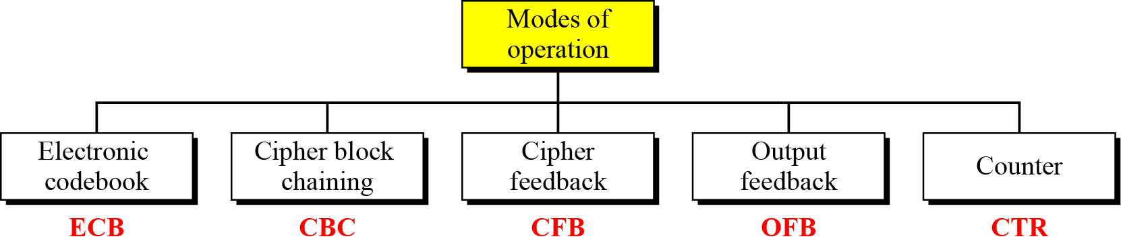
Continued
Figure Modes of operation

Slide 6
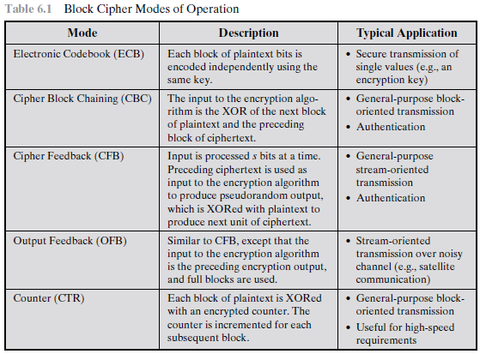

Slide 7
Electronic Codebook Book (ECB)
message is broken into independent blocks that are encrypted
each block is a value which is substituted, like a codebook, hence name
each block is encoded independently of the other blocks
C_{i} = E_{K}(P_{i})
uses: secure transmission of single values

Slide 8
Original
ECB
Better

Slide 9
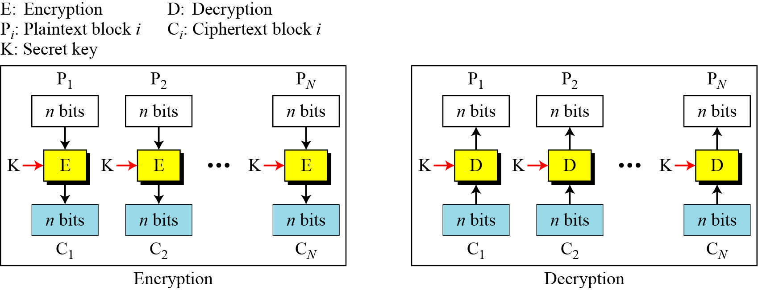
Electronic Codebook (ECB) Mode
The simplest mode of operation is called the electronic codebook (ECB) mode.
Figure Electronic codebook (ECB) mode

Slide 10
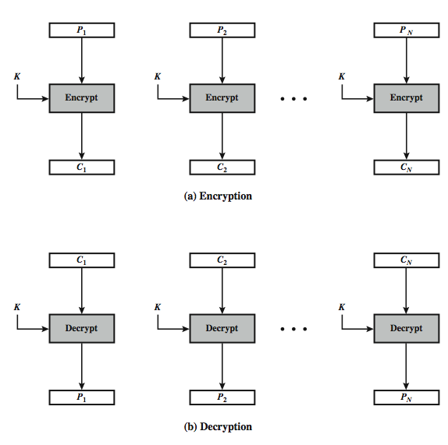
Electronic Codebook (ECB) Mode

Slide 11
Continued
Example
It can be proved that each plaintext block at Alice’s site is exactly recovered at Bob’s site. Because encryption and decryption are inverses of each other,
Example
This mode is called electronic codebook because one can precompile 2^{K} codebooks (one for each key) in which each codebook has 2^{n} entries in two columns. Each entry can list the plaintext and the corresponding ciphertext blocks. However, if K and n are large, the codebook would be far too large to precompile and maintain.

Slide 12
Continued
Example
Assume that Eve works in a company a few hours per month (her monthly payment is very low). She knows that the company uses several blocks of information for each employee in which the seventh block is the amount of money to be deposited in the employee’s account. Eve can intercept the ciphertext sent to the bank at the end of the month, replace the block with the information about her payment with a copy of the block with the information about the payment of a full-time colleague. Each month Eve can receive more money than she deserves.

Slide 13
Evaluating block cipher modes of
operation
Overhead
Error recovery:
Error propagation:
Diffusion:
Security:

Slide 14
Advantages and Limitations of ECB
message repetitions may show in ciphertext
if aligned with message block
particularly with data such graphics
or with messages that change very little, which become a code-book analysis problem
weakness is due to the encrypted message blocks being independent
vulnerable to cut-and-paste attacks
main use is sending a few blocks of data

Slide 15


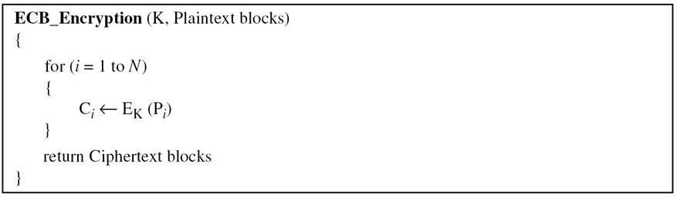
Continued
Error Propagation
A single bit error in transmission can create errors in several in the corresponding block. However, the error does not have any effect on the other blocks.

Slide 16
Continued
Ciphertext Stealing
A technique called ciphertext stealing (CTS) can make it possible to use ECB mode without padding. In this technique the last two plaintext blocks, P_{N−1} and P_{N} , are encrypted differently and out of order, as shown below, assuming that P_{N−1} has n bits and P_{N} has m bits, where m ≤ n .

Slide 17
Ciphertext Stealing
Use to make ciphertext length same as plaintext length
Requires more than one block of ptxt
Pn-1
Pn
Pn-1
Pn
En
Dn
En-1
En-1
Head n
T
Head n
T
Pn
T
Pn
T
En
Dn
En-1
Head n
En-1
Head n

Slide 18
Message Padding
at end of message must handle a possible last short block
which is not as large as blocksize of cipher
pad either with known non-data value
e.g., nulls
or pad last block along with count of pad size
e.g., [ b1 b2 b3 0 0 0 0 5]
means have 3 data bytes, then 5 bytes pad+count
this may require an extra entire block over those in message
there are other, more esoteric modes, which avoid the need for an extra block
Notes:
18
One issue that arises with block modes is how to handle the last block, which may well not be complete. In general have to pad this block (typically with 0's), and then must recognise padding at other end - may be obvious (eg in text the 0 value should usually not occur), or otherwise must explicitly have the last byte as a count of how much padding was used (including the count). Note that if this is done, if the last block IS an even multiple of 8 bytes or has exactly the same form as pad+count, then will have to add an extra block, all padding so as to have a count in the last byte. There are other, more esoteric, “ciphertext stealing” modes, which avoid the need for an extra block.

Slide 19
Cipher Block Chaining (CBC)
message is broken into blocks
linked together in encryption operation
each previous cipher block is chained with current plaintext block, hence name
use Initial Vector (IV) to start process
C_{i} = E_{K}(P_{i} XOR C_{i-1})
C₋₁ = IV
IV prevents same P from making same C
uses: bulk data encryption, authentication
Notes:
19
To overcome the problems of repetitions and order independence in ECB, want some way of making the ciphertext dependent on all blocks before it. The CBC provides this, by combining the previous ciphertext block with the current message block before encrypting. In effect, we have chained together the processing of the sequence of plaintext blocks. The input to the encryption function for each plaintext block bears no fixed relationship to the plaintext block. Therefore, repeating patterns of b bits are not exposed. For decryption, each cipher block is passed through the decryption algorithm. The result is XORed with the preceding ciphertext block to produce the plaintext block. To produce the first block of ciphertext, an initialization vector (IV) is XORed with the first block of plaintext. On decryption, the IV is XORed with the output of the decryption algorithm to recover the first block of plaintext. The IV is a data block that is that same size as the cipher block, and is either well known (often all 0's), or otherwise is sent, ECB encrypted, just before starting CBC use. CBC mode is applicable whenever large amounts of data need to be sent securely, provided that all data is available in advance (eg email, FTP, web etc).

Slide 20
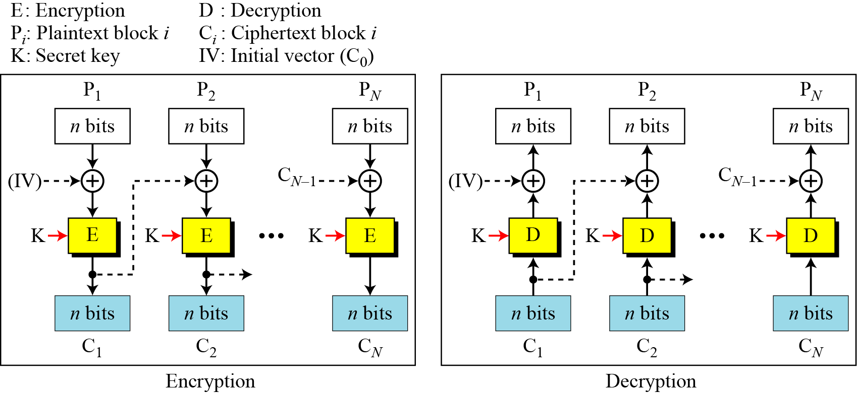
Cipher Block Chaining (CBC) Mode
In CBC mode, each plaintext block is exclusive-ored with the previous ciphertext block before being encrypted.
Figure Cipher block chaining (CBC) mode

Slide 21
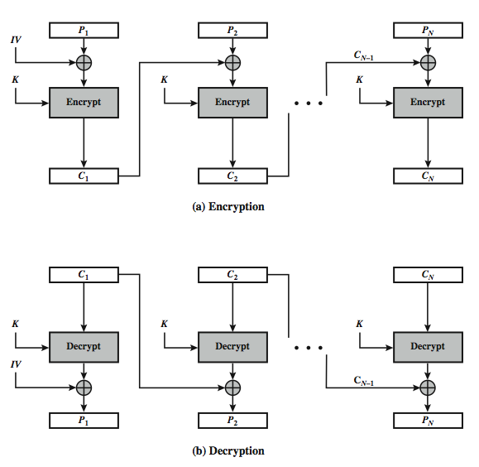
Cipher Block Chaining (CBC) Mode

Slide 22
Continued
Cipher block chaining (CBC) mode

Slide 23
Continued
Example
It can be proved that each plaintext block at Alice’s site is recovered exactly at Bob’s site. Because encryption and decryption are inverses of each other,
Initialization Vector (IV)
The initialization vector (IV) should be known by the sender and the receiver.

Slide 24
Continued
Error Propagation
In CBC mode, a single bit error in ciphertext block C_{j} during transmission may create error in most bits in plaintext block P_{j} during decryption.

Slide 25
Continued
Ciphertext Stealing
The ciphertext stealing technique described for ECB mode can also be applied to CBC mode, as shown below.
The head function is the same as described in ECB mode; the pad function inserts 0’s.

Slide 26
Stream Modes of Operation

Slide 27
Stream Modes of Operation
block modes encrypt entire block
may need to operate on smaller units
real time data
convert block cipher into stream cipher
cipher feedback (CFB) mode
output feedback (OFB) mode
counter (CTR) mode
use block cipher as some form of pseudo-random number generator...

Slide 28

Cipher Feed Back (CFB)
message is treated as a stream of bits
added to the output of the block cipher
result is feed back for next stage (hence name)
standard allows any number of bits (1,8, 64 or 128 etc) to be feed back
denoted CFB-1, CFB-8, CFB-64, CFB-128, etc.
most efficient to use all bits in block (64 or 128)
C_{i} = P_{i} XOR E_{K}(C_{i-1})
C₋₁ = IV
uses: stream data encryption, authentication

Slide 29
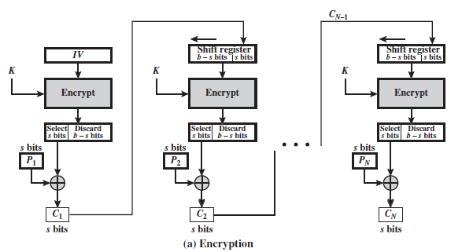
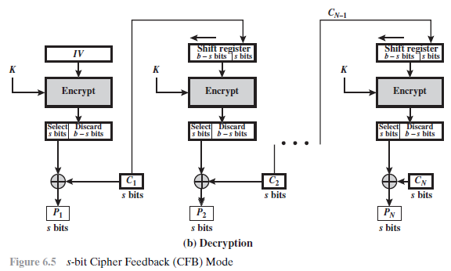

Slide 30
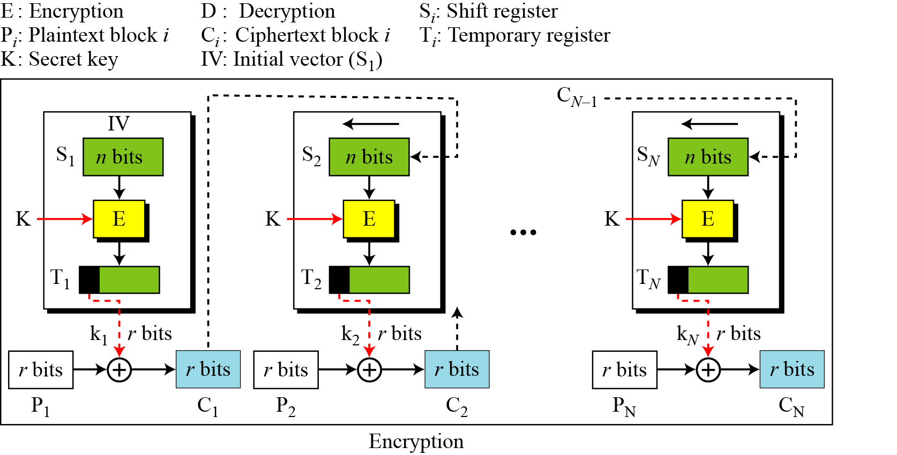
Cipher Feedback (CFB) Mode
In some situations, we need to use DES or AES as secure ciphers, but the plaintext or ciphertext block sizes are to be smaller.
Figure Encryption in cipher feedback (CFB) mode

Slide 31
Continued
In CFB mode, encipherment and decipherment use the encryption function of the underlying block cipher.
The relation between plaintext and ciphertext blocks is shown below:

Slide 32
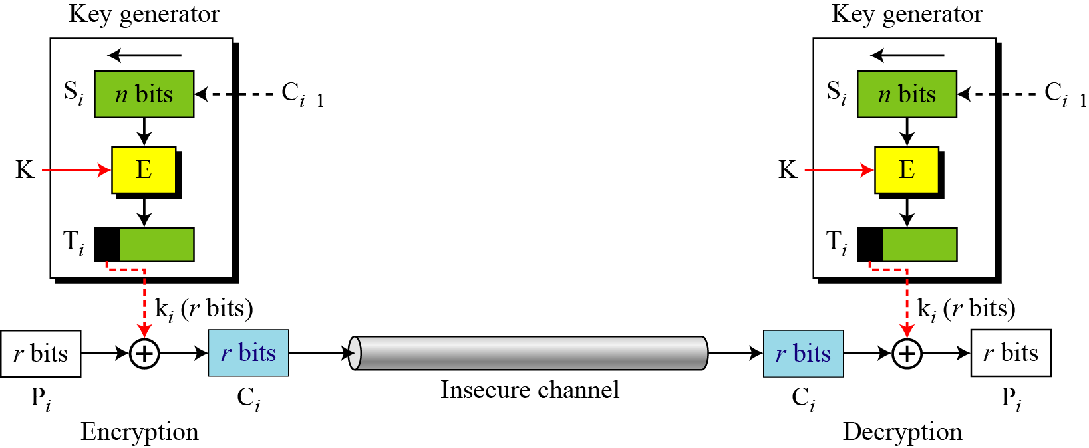
Continued
CFB as a Stream Cipher
Figure Cipher feedback (CFB) mode as a stream cipher

Slide 33
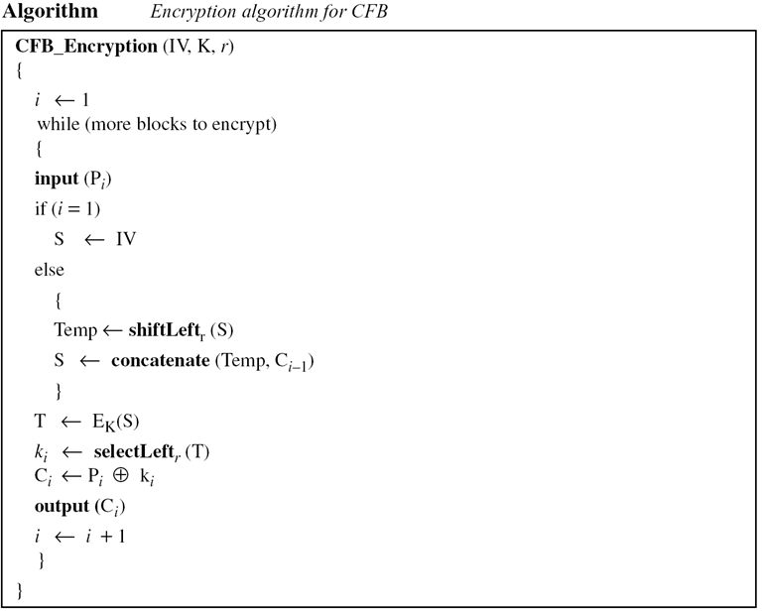
Continued

Slide 34
Advantages and Limitations of CFB
most common stream mode
appropriate when data arrives in bits/bytes
limitation is need to stall while do block encryption after every s-bits
note that the block cipher is used in encryption mode at both ends (XOR)
errors propagate for several blocks after the error

Slide 35

Output FeedBack (OFB)
message is treated as a stream of bits
output of cipher is added to message
output is then feed back (hence name)
O_{i} = E_{K}(O_{i-1})
C_{i} = P_{i} XOR O_{i}
O₋₁ = IV
feedback is independent of message
can be computed in advance
uses: stream encryption on noisy channels
Why noisy channels?

Slide 36
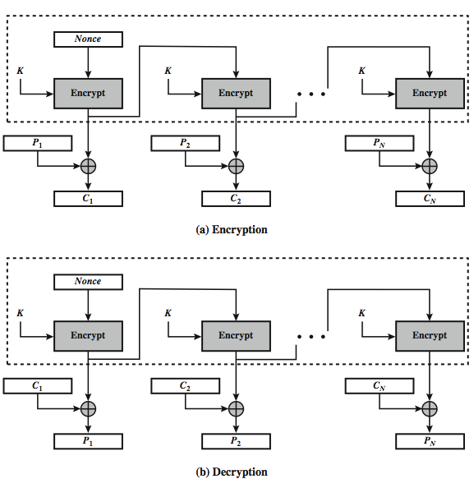
Output FeedBack (OFB)

Slide 37
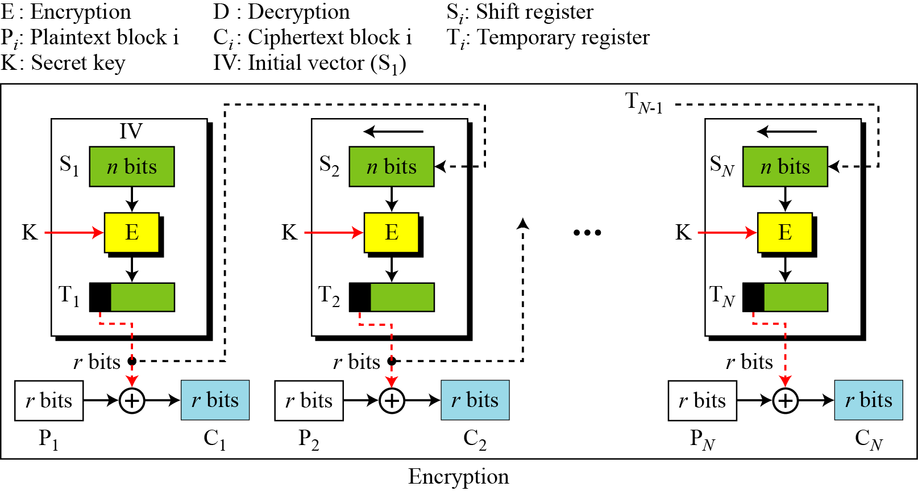
Output Feedback (OFB) Mode
In this mode each bit in the ciphertext is independent of the previous bit or bits. This avoids error propagation.
Figure Encryption in output feedback (OFB) mode

Slide 38
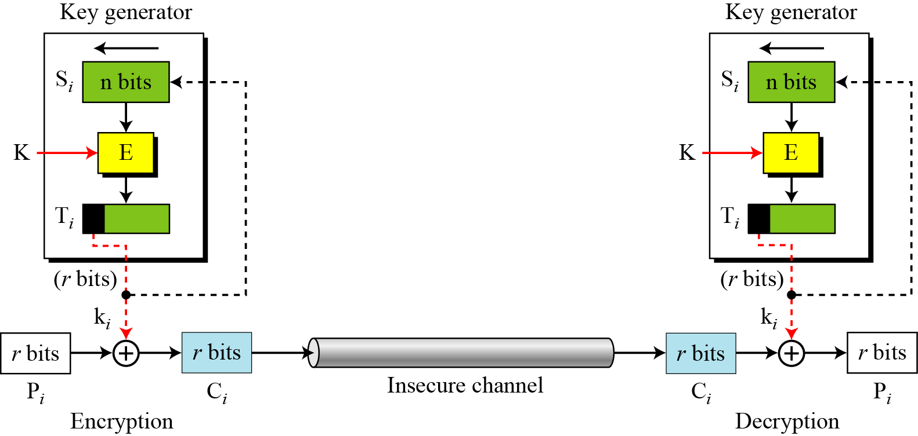
Continued
OFB as a Stream Cipher
Figure Output feedback (OFB) mode as a stream cipher

Slide 39
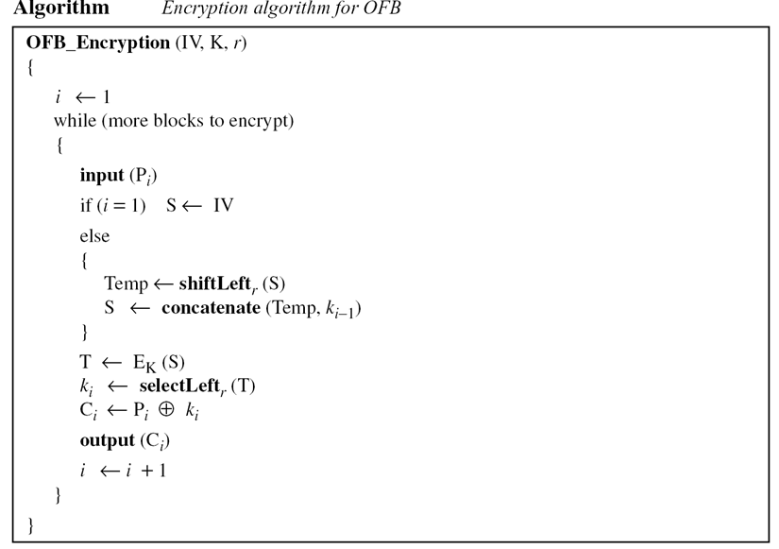
Continued

Slide 40
Advantages and Limitations of OFB
needs an IV which is unique for each use
if ever reuse attacker can recover outputs...
can pre-compute
bit errors do not propagate
more vulnerable to message stream modification...
change arbitrary bits by changing ciphertext
sender & receiver must remain in sync
only use with full block feedback
subsequent research has shown that only full block feedback (ie CFB-64 or CFB-128) should ever be used

Slide 41
Counter (CTR) mode
a “new” mode, though proposed many years before
similar to OFB but encrypts counter value rather than any feedback value
O_{i} = E_{K}(i)
C_{i} = P_{i} XOR O_{i}
must have a different key & counter value for every plaintext block (never reused)
again, OTP issue
uses: high-speed network encryptions

Slide 42
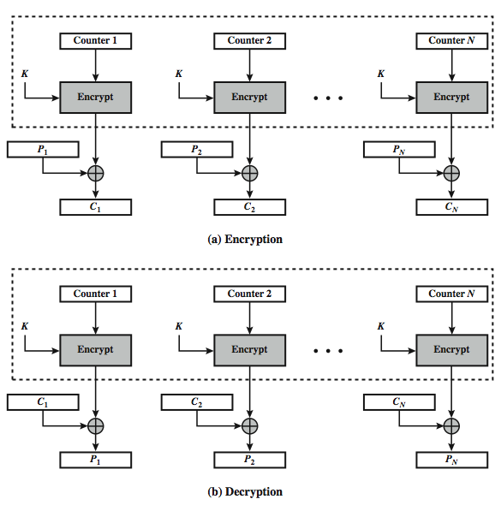
Counter (CTR) mode

Slide 43
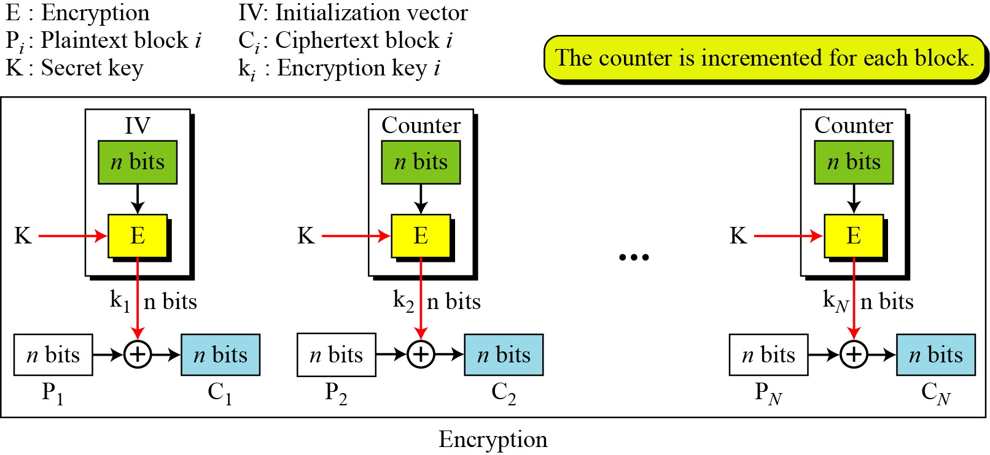
Counter (CTR) Mode
In the counter (CTR) mode, there is no feedback. The pseudorandomness in the key stream is achieved using a counter.
Figure Encryption in counter (CTR) mode

Slide 44
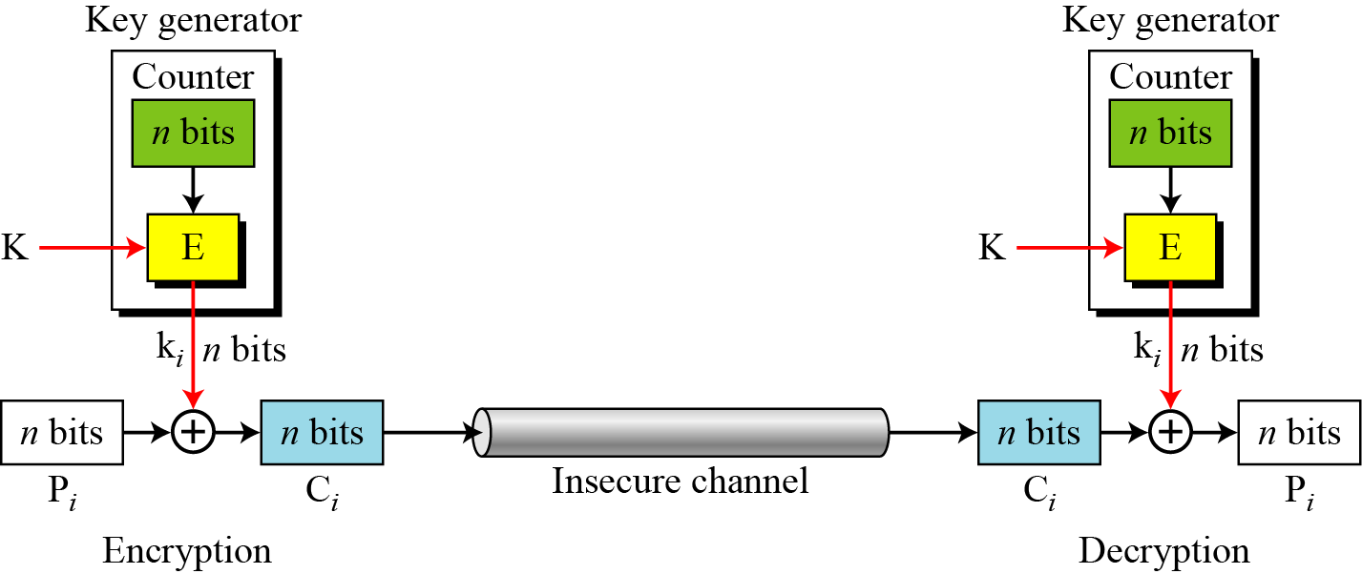
Continued
Figure Counter (CTR) mode as a stream cipher

Slide 45
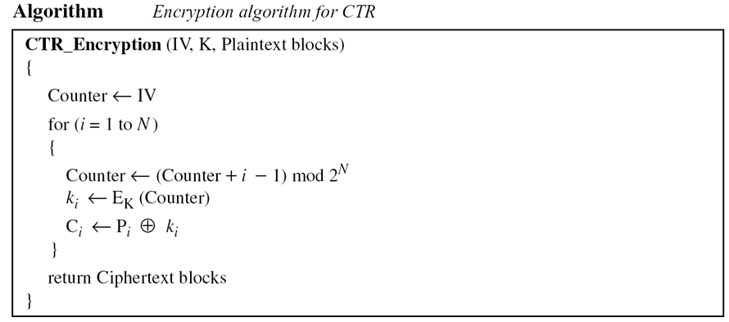
Continued

Slide 46
Advantages and Limitations of CTR
efficiency
can do parallel encryptions in h/w or s/w
can preprocess in advance of need
good for bursty high speed links
random access to encrypted data blocks
provable security (good as other modes)
never have cycle less than 2^{b}
but must ensure never reuse key/counter values, otherwise could break (cf OFB)

Slide 47
XTS-AES Mode
need mode for block oriented storage
No extra room in sector – data only
Disk addressed by sector number
Encryption can only take key externally
Encryption can also use sector#, block#
Access to any sector should be independent of other sectors
Must prevent attack that copies sector to unused sector, then requests decryption
Notes:
47
NIST is currently in the process of approving an additional block cipher mode of operation, XTS-AES. This mode is also an IEEE standard, IEEE Std 1619-2007, which describes a method of encryption for data stored in sector-based devices. The XTS-AES mode is based on the concept of a tweakable block cipher. The requirements for encrypting stored data, also referred to as "data at rest" differ somewhat from those for transmitted data (see text for list). Encryption of a single block involves two instances of the AES algorithm with two keys, and a number of parameters (see text). In essence, the parameter j is the block number within the sector, and i is the 128-bit tweak for the sector. Each data unit (sector) is assigned a tweak value that is a nonnegative integer. The tweak values are assigned consecutively, starting from an arbitrary nonnegative integer.
The plaintext of a sector or data unit is organized in to blocks of 128 bits, hence the input to the XTS-AES algorithm consists of m 128-bit blocks and possibly a final partial block. For encryption and decryption, each block is treated independently and encrypted. The only exception occurs when the last block has less than 128 bits. In that case, the last two blocks are encrypted/decrypted using a ciphertext- stealing technique instead of padding.

Slide 48
General structure of a tweakable
block cipher
The XTS-AES mode is based on the concept of a tweakable block cipher. The general structure of a tweakable block cipher. A tweakable block cipher is one that has three inputs: a plaintext P, a symmetric key K, and a tweak T; and produces a ciphertext output C. We can write this as C = E(K, T, P). The tweak need not be kept secret. Whereas the purpose of the key is to provide security, the purpose of the tweak is to provide variability.

Slide 49
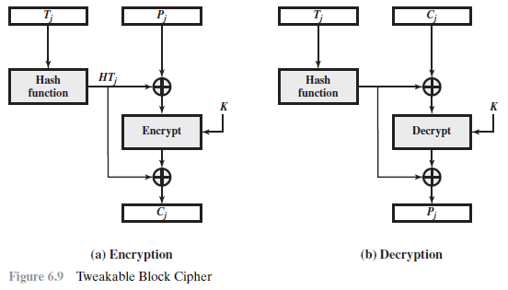


Slide 50
XTS-AES Mode
new mode, for block oriented storage use
in IEEE Std 1619-2007
concept of tweakable block cipher
different requirements to transmitted data
uses AES twice for each block
T_{j} = E_{K2}(i) XOR α^{j}
C_{j} = E_{K1}(P_{j} XOR T_{j}) XOR T_{j}
where i is tweak & j is sector no
each sector may have multiple blocks
Notes:
50
NIST is currently in the process of approving an additional block cipher mode of operation, XTS-AES. This mode is also an IEEE standard, IEEE Std 1619-2007, which describes a method of encryption for data stored in sector-based devices. The XTS-AES mode is based on the concept of a tweakable block cipher. The requirements for encrypting stored data, also referred to as "data at rest" differ somewhat from those for transmitted data (see text for list). Encryption of a single block involves two instances of the AES algorithm with two keys, and a number of parameters (see text). In essence, the parameter j is the block number within the sector, and i is the 128-bit tweak for the sector. Each data unit (sector) is assigned a tweak value that is a nonnegative integer. The tweak values are assigned consecutively, starting from an arbitrary nonnegative integer.
The plaintext of a sector or data unit is organized in to blocks of 128 bits, hence the input to the XTS-AES algorithm consists of m 128-bit blocks and possibly a final partial block. For encryption and decryption, each block is treated independently and encrypted. The only exception occurs when the last block has less than 128 bits. In that case, the last two blocks are encrypted/decrypted using a ciphertext- stealing technique instead of padding.

Slide 51
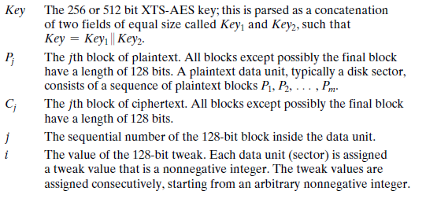
The following parameters are associated with the algorithm.
The plaintext of a sector or data unit is organized into blocks of 128 bits. Blocks are labeled P0, P1, …, Pm. The last block my be null or may contain from 1 to 127 bits.

Slide 52
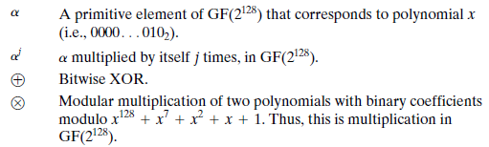

Slide 53
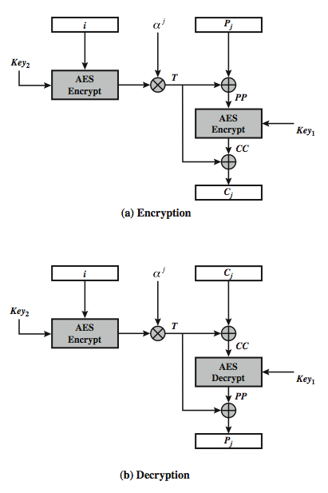

XTS-AES Mode per block
Key whitening applied by XOR
With “tweak” that depends on
- sector
- block
- second key
Makes attacks more difficult
Makes operations depend on
data location
Notes:
53
Stallings Figure 6.9 illustrates the operation of the XTS-AES mode on a single block.

Slide 54
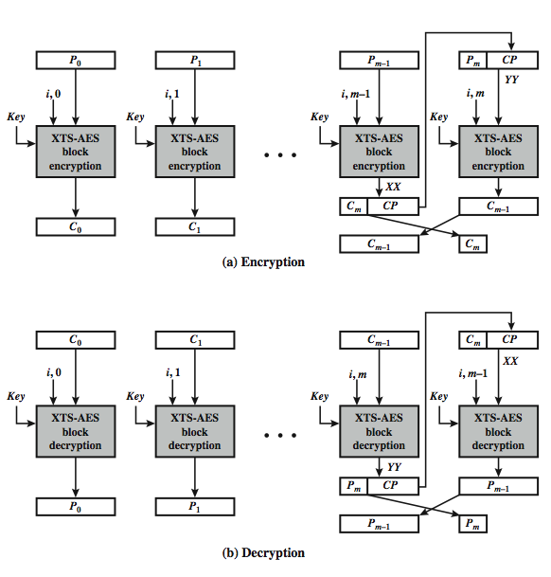
XTS-AES Mode Overview: Cipher text stealing
Notes:
54
Stallings Figure 6.10 illustrates the ciphertext- stealing technique used in XTS-AES. This ensures that the encrypted data remains the same size as the original plaintext, which it must to fit on a block-oriented storage device. See text for more details.

Slide 55
Advantages and Limitations of XTS-AES
efficiency
can do parallel encryptions in h/w or s/w
random access to encrypted data blocks
has both nonce & counter
addresses security concerns related to stored data
Notes:
55
XTS-AES mode, like CTR mode, is suitable for parallel operation: because there is no chaining, multiple blocks can be encrypted or decrypted simultaneously. Unlike CTR mode, XTS-AES mode includes a nonce (the parameter i) as well as a counter (parameter j).

Slide 56
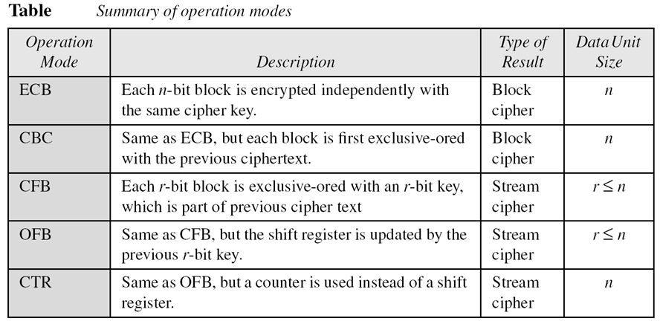
Continued
Comparison of Different Modes

Slide 57
USE OF STREAM CIPHERS
Although the five modes of operations enable the use of block ciphers for encipherment of messages or files in large units(ECB, CBC, and CTR) and small units(CFB and OFB), sometimes pure stream are needed for enciphering small units of data such as characters or bits. Stream ciphers are efficient for real-time processing.
Topics discussed in this section:
RC4 A5/1

Slide 58
RC4
RC4 (designed by Ronald Rivest, 1984) is a byte-oriented stream cipher in which a byte (8 bits) of a plaintext is exclusive-ored with a byte of key to produce a byte of a ciphertext. Used in SSL/TLS and in IEEE 802.11 wireless LAN.
State
RC4 is based on the concept of a state. At each momment a sate of 256 bytes is active, from which one of the bytes is randomly selected to serve as the key for encryption. The content of each element is also a byte.

Slide 59
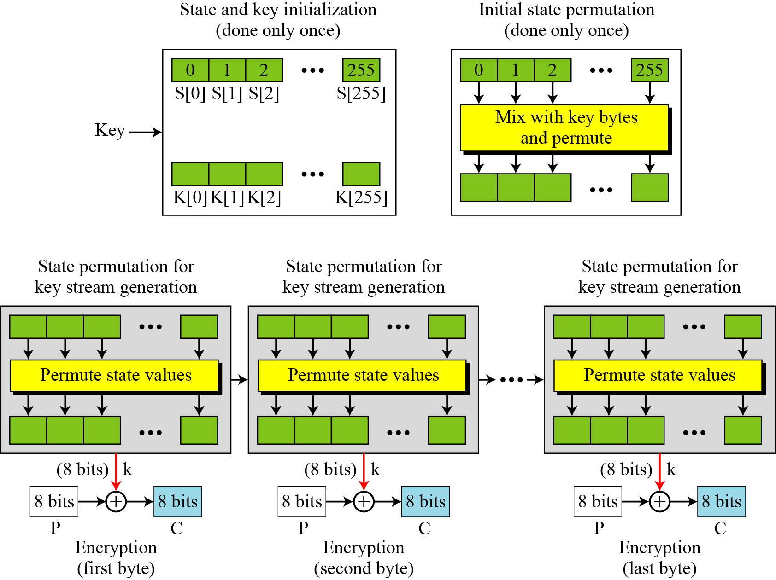
Continued
Figure The idea of RC4 stream cipher
Only once used

Slide 60
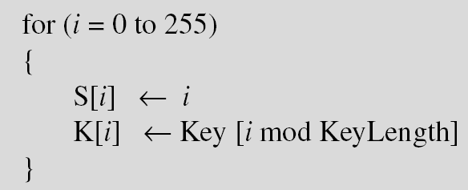
Continued
Initialization
Initialization is done in two steps:
Key Stream Generation
The keys in the key stream are generated, one by one. i, j initialized to 0.

Slide 61
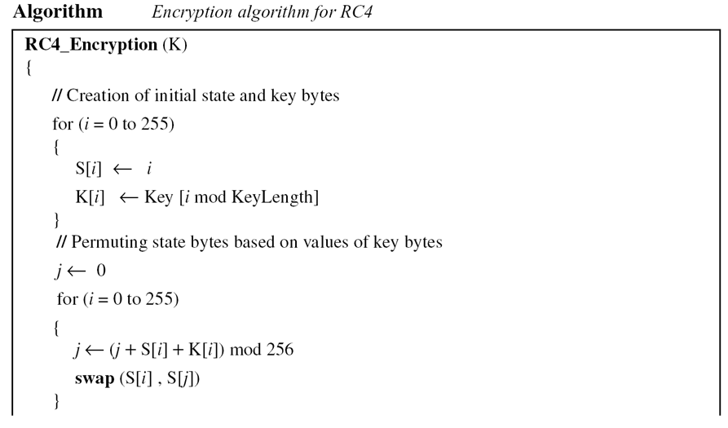
Continued
Algorithm

Slide 62
Continued
Algorithm Continued

Slide 63
Continued
Example
To show the randomness of the stream key, we use a secret key with all bytes set to 0. The key stream for 20 values of k is (222, 24, 137, 65, 163, 55, 93, 58, 138, 6, 30, 103, 87, 110, 146, 109, 199, 26, 127, 163).
Example
Repeat Example 8.5, but let the secret key be five bytes of (15, 202, 33, 6, 8). The key stream is (248, 184, 102, 54, 212, 237, 186, 133, 51, 238, 108, 106, 103, 214, 39, 242, 30, 34, 144, 49). Again the randomness in the key stream is obvious.

Slide 64
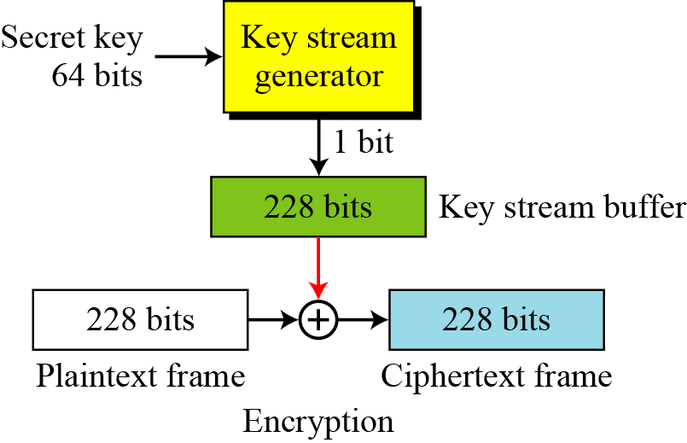
A5/1
A5/1 (a member of the A5 family of ciphers) based on LFRS is used in the Global System for Mobile Communication (GSM), a network for mobile telephone communication. It is done as a sequence of 228 bit frames in which each frame lasts4.6 milli seconds. 64 bit key. The bit stream are collected in a 228 bit buffer.
Figure General outline
of A5/1

Slide 65
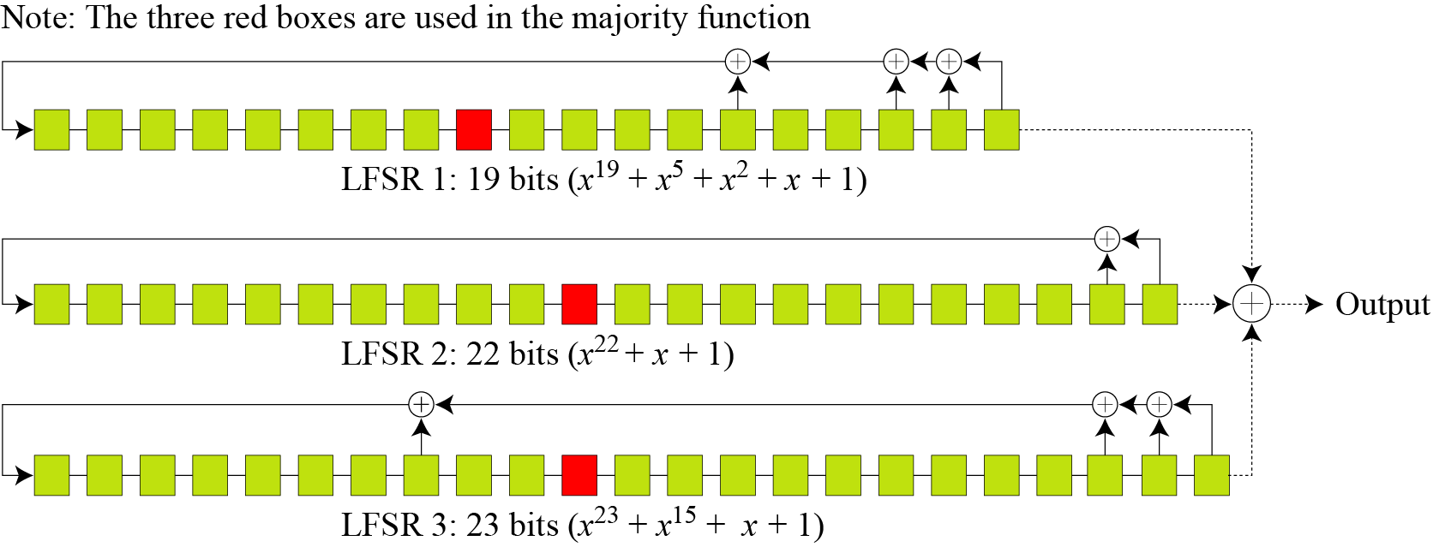
Continued
Key Generator
A5/1 uses three LFSRs with 19, 22, and 23 bits.
Figure Three LFSR’s in A5/1

Slide 66
Continued
Initialization
1. set all bits in three LFSRs to 0.
2.
3.

Slide 67
Continued
4.
Majority Function:
Majority(b1,b2,b3,b4)=1 if majority bits 1
Else 0
Use LFSR1[10], LFSR2[11] and LFSR2[11] (counting from right)

Slide 68
Continued
Example
At a point of time the clocking bits are 1, 0, and 1. Which LFSR is clocked (shifted)?
Solution
The result of Majority (1, 0, 1) = 1. LFSR1 and LAFS3 are shifted, but LFSR2 is not.

Slide 69
Continued
Encryption/Decryption
The bit streams created from the key generator are buffered to form a 228-bit key that is exclusive-ored with the plaintext frame to create the ciphertext frame. Encryption/decryption is done one frame at a time.

Slide 70
OTHER ISSUES
Encipherment using symmetric-key block or stream ciphers requires discussion of other issues.
Topics discussed in this section:
Key Management Key Generation

Slide 71
Key Management
Alice and Bob need to share a secret key between themselves to securely communicate using a symmetric-key cipher. If there are n entities in the community, n(n − 1)/2 keys are needed.

Slide 72
Key Generation
Different symmetric-key ciphers need keys of different sizes. The selection of the key must be based on a systematic approach to avoid a security leak. The keys need to be chosen randomly. This implies that there is a need for random (or pseudorandom) number generator.

Slide 73
Stream Ciphers revisited

Slide 74
MODERN STREAM CIPHERS
In a modern stream cipher, encryption and decryption
are done r bits at a time. We have a plaintext bit stream P = p_{n}…p₂ p₁, a ciphertext bit stream C = c_{n}…c₂ c₁, and a key bit stream K = k_{n}…k₂ k₁, in which p_{i} , c_{i} , and k_{i} are r-bit words.
Topics discussed in this section:
Synchronous Stream Ciphers Nonsynchronous Stream Ciphers

Slide 75
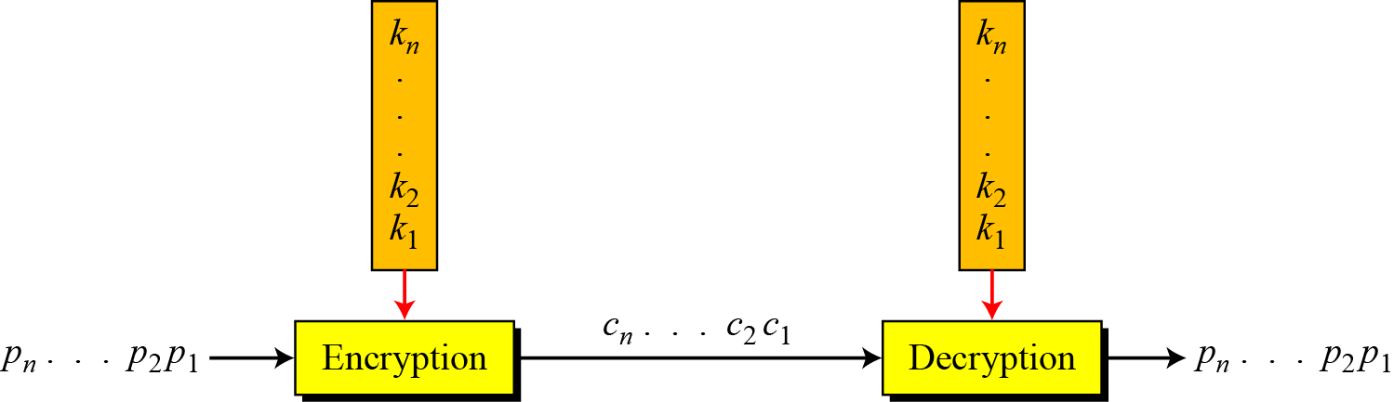

Continued
Figure Stream cipher
Note
In a modern stream cipher, each r-bit word in the plaintext stream is enciphered using an r-bit word in the key stream to create the corresponding r-bit
word in the ciphertext stream.

Slide 76
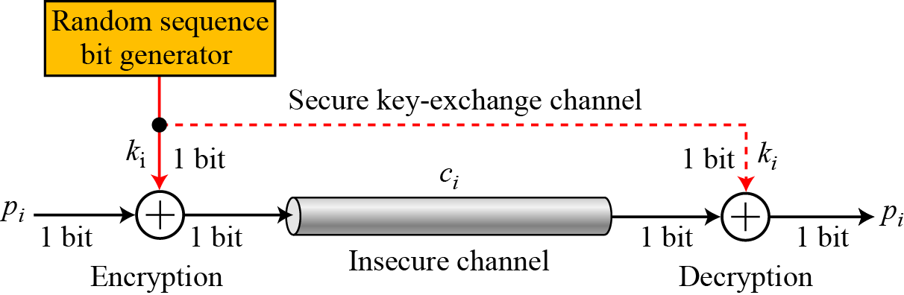
Synchronous Stream Ciphers
Note
In a synchronous stream cipher the key is independent of the plaintext or ciphertext.
Figure One-time pad

Slide 77
Continued
Example
What is the pattern in the ciphertext of a one-time pad cipher in each of the following cases?
a. The plaintext is made of n 0’s.
b. The plaintext is made of n 1’s.
c. The plaintext is made of alternating 0’s and 1’s.
d. The plaintext is a random string of bits.
Solution
Because 0 ⊕ k_{i} = k_{i} , the ciphertext stream is the same as the key stream. If the key stream is random, the ciphertext is also random. The patterns in the plaintext are not preserved in the ciphertext.

Slide 78
Continued
Example
(Continued)
Because 1 ⊕ k_{i} = k_{i} where k_{i} is the complement of k_{i} , the ciphertext stream is the complement of the key stream. If the key stream is random, the ciphertext is also random. Again the patterns in the plaintext are not preserved in the ciphertext.
In this case, each bit in the ciphertext stream is either the same as the corresponding bit in the key stream or the complement of it. Therefore, the result is also a random string if the key stream is random.
In this case, the ciphertext is definitely random because the exclusive-or of two random bits results in a random bit.

Slide 79
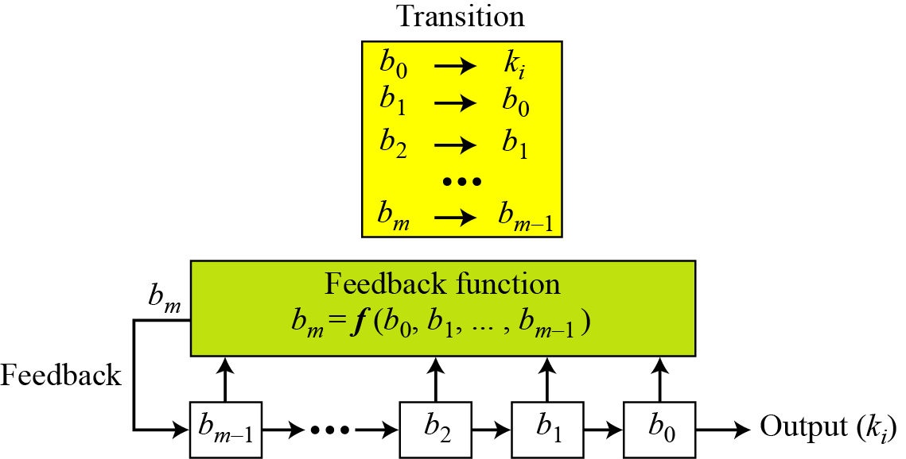
Continued
Figure Feedback shift register (FSR)

Slide 80
Continued
Example
Create a linear feedback shift register with 5 cells in which
b₅ = b₄ ⊕ b₂ ⊕ b₀ .
Solution
If c_{i} = 0, b_{i} has no role in calculation of b_{m}. This means that b_{i} is not connected to the feedback function. If c_{i} = 1, b_{i} is involved in calculation of bm. In this example, c1 and c3 are 0’s, which means that we have only three connections. Figure 5.24 shows the design.

Slide 81
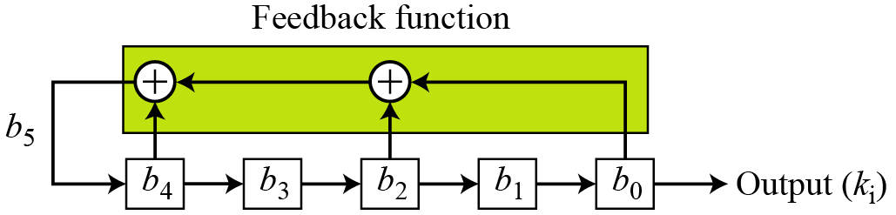
Confidentiality
Figure LSFR for Example

Slide 82
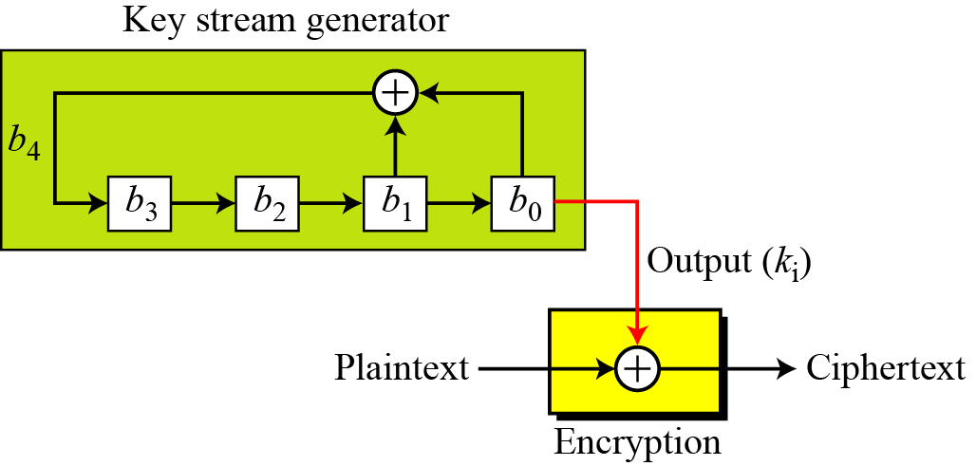
Continued
Example
Create a linear feedback shift register with 4 cells in which
b₄ = b₁ ⊕ b₀. Show the value of output for 20 transitions (shifts) if the seed is (0001)₂.
Solution
Figure LFSR for Example

Slide 83
Continued
Example
(Continued)
Table Cell values and key sequence for Example

Slide 84
Continued
Example
(Continued)
Table Continued

Slide 85
Continued
Example
(Continued)
Note that the key stream is 100010011010111 10001…. This looks like a random sequence at first glance, but if we go through more transitions, we see that the sequence is periodic. It is a repetition of 15 bits as shown below:
The key stream generated from a LFSR is a pseudorandom sequence in which the the sequence is repeated after N bits.
Note
The maximum period of an LFSR is to 2^{m} − 1.

Slide 86
Continued
Example
The characteristic polynomial for the LFSR in Example is (x⁴ + x + 1), which is a primitive polynomial. It is an irreducible polynomial. This polynomial also divides (x⁷ + 1) = (x⁴ + x + 1) (x³ + 1), which means e = 2³ − 1 = 7.

Slide 87
Nonsynchronous Stream Ciphers
In a nonsynchronous stream cipher, each key in the key stream depends on previous plaintext or ciphertext.
Note
In a nonsynchronous stream cipher, the key depends on either the plaintext or ciphertext.

